Slide 1
Local Image Translation Program
Sinyoung Kwon, Seoul National University

Slide 2
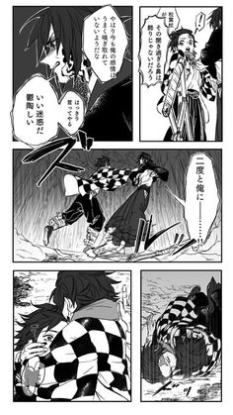
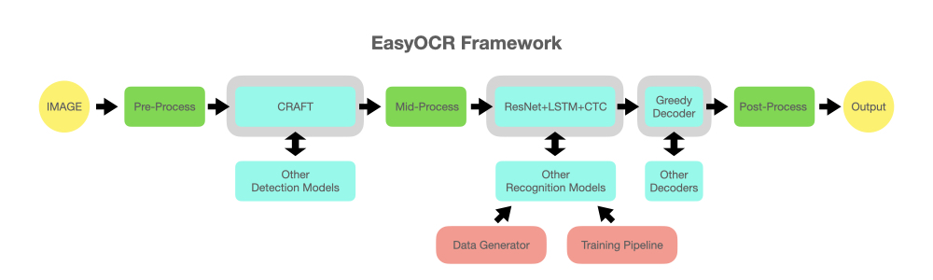
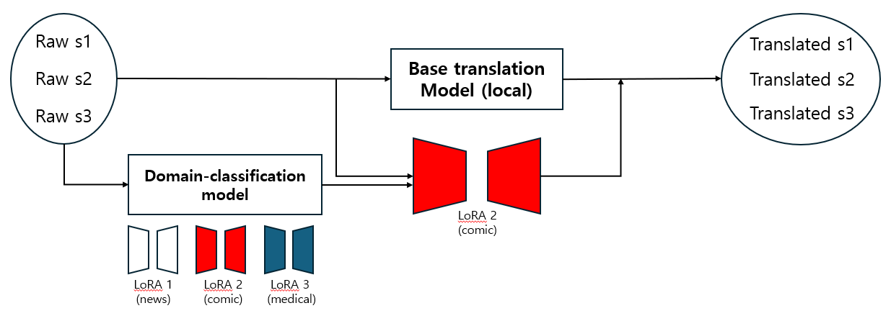
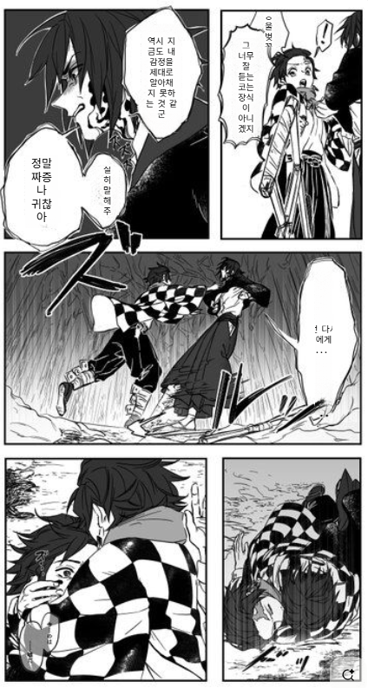
IMAGE
EasyOCR Framework
Raw Sentences
やはり今日も俺の感情を..
二度と俺に…
Domain-specific Translation Model
Translated Sentence
역시 오늘도 내 감정을..
두 번 다시 내게..
Sentence-placing program
Resulting IMAGE
역시 오
늘도 내 감
정을..
역시
오늘도
내
감정을..

Slide 3
EasyOCR Framework
https://github.com/JaidedAI/EasyOCR

Slide 4
Domain-specific Translation Model
Raw s1
Translated s1
Base translation
Model (local)
Raw s2
Translated s2
Raw s3
Translated s3
Domain-classification model
LoRA 2
(comic)
LoRA 1
(news)
LoRA 2
(comic)
LoRA 3
(medical)

Slide 5
Select Base Translation model
Choose a small model that can be run locally
(Optional) fine-tuning with large dataset
Ex) OPUS-MT, Helsinki-NLP..

Slide 6
Train LoRA
LLMs already have great performance; so if we prompt well for the domain, it produces great translation results at a level that does not require human post-processing.
Using transfer learning, train LoRA domain-specifically.
In actual translation phase, use domain-classification model to determine which LoRA to use.
  I don't think it's going to be that hard.
  Comics, medical, … (default LoRA)

Slide 7
Benchmarking Service: translatemanga.net
https://translatemanga.net/en
Drawbacks
  The translation is not completely smooth (little improvement seems possible)
  The translation sentence placing, font size, etc. (not neat, requiring human intervention)
  LLM API call base, external service dependent
Differences from my project
  (Goal) more natural translation
  Appropriate font selection and placement location considering spacing of translated sentences, etc
  Run on Local

